Slide 1


Content Engagement Analysis Maximizing Audience Reach and Consistency

Slide 2


Today's agenda
Project Recap
Problem Statement
The Analytics Team
Analysis Process
Findings and Insights
Recommendations
Summary

Slide 3

Social Buzz is a fast growing technology unicorn that need to adapt quickly to it's global scale.
Accenture has begun a 3 month POC focusing on these tasks:
An audit of Social Buzz's big data practice
Recommendations for a successful IPO
Analysis to find Social Buzz's top 5 most popular categories of content
Project Recap

Slide 4

Over 1,00,000 posts per day
36,500,000 pieces of content per year!
But how to capitalize on it when
there is so much?
** Analysis to find Social Buzz's top 5 most popular categories of content
Problem

Slide 5



Andrew Fleming
Chief Technical Architect
The Analytics team
Marcus Rompton
Senior Principle
Darshan Kolate
Data analysis

Slide 6
1
We initiated the analysis by cleaning and consolidating data from multiple files into a single dataset using Excel.
2
The critical steps included data cleaning, merging, and pre processing to ensure data accuracy.
3
We utilized Excel functions such as VLOOKUP and SUMIF to perform data operations efficiently.
Process
4
Our analytical approach was designed to unveil the top content categories with the highest aggregate popularity.

Slide 7
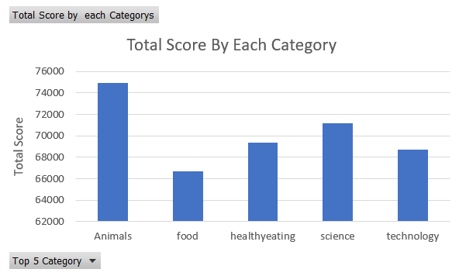

Insights
1
* These findings shed light on the content areas that capture the most attention and engagement from our audience.

Slide 8
* Our analysis revealed the following top 5 performing content categories, ranked by total score:
Animals: 74,965
Science: 71,168
Technology: 68,738
Healthy Eating: 69,339
Food: 66,676

Slide 9
2
The analysis reveals a diverse range of content categories, with a total of 16 unique categories.
This diversity suggests that your content strategy successfully caters to a broad spectrum of interests and preferences among your audience.
To maintain and leverage this diversity, consider periodically assessing the performance of each category to ensure that you continue to meet the evolving interests of your audience.

Slide 10
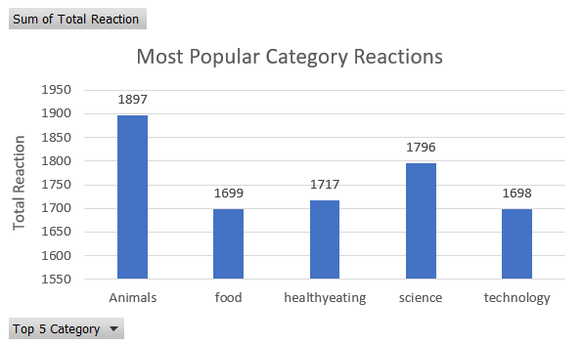
3
* This suggests the potential for cross-category content initiatives to enhance the overall user experience and reach.

Slide 11
The top categories, including Animals, Science, Healthy Eating, Technology, and Food, exhibit similar total reaction counts, suggesting a stable and engaged audience across diverse interests.
This consistency may indicate a well-balanced content strategy that resonates with a broad range of audience segments.
Leveraging this engagement consistency, consider exploring cross-category content initiatives and collaborations to enhance the overall user experience and reach.

Slide 12
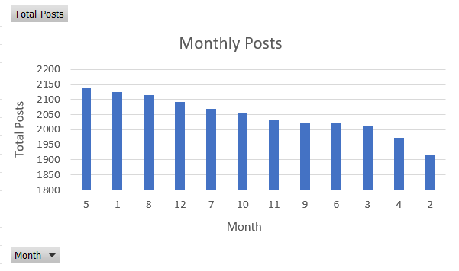
4
* Understanding these posting trends can help optimize content planning and resource allocation throughout the year, ensuring that content is strategically timed to reach the audience effectively.

Slide 13
The data indicates varying posting activity throughout the year.
May (Month 5) saw the highest number of posts with 2,138, making it the most active month.
February (Month 2) had the lowest number of posts with 1,914.
There is a noticeable trend of higher posting activity in the early months of the year (January, February) and a peak in May, possibly reflecting seasonal content patterns.

Slide 14
Recommendations
Allocate additional resources and attention to the top-performing categories to further enhance user engagement and satisfaction.
Explore cross-category content initiatives and collaborations to leverage the consistent audience engagement across diverse interests.
Use insights from monthly posting trends to strategically time content releases and maximize audience reach.

Slide 15

In summary, This project summary encapsulates the key findings, insights, and recommendations derived from the content engagement analysis, highlighting the significance of understanding audience behavior and optimizing content strategy accordingly.
Summary

Slide 16

Thank you!
ANY QUESTIONS?

